Slide 1
Distributed Synchronization
In this presentation site refers to process

Slide 2
Mutual exclusion (ME)
Mutual exclusion : makes sure that concurrent process access shared resources or data in a serialized way.
If a process , say P_{i} , is executing in its critical section, then no other processes can be executing in their critical sections
Example:
  updating a DB
  Directory management
  sending control signals to an IO device
Two basic approaches to ME in distributed systems can be identified:
  Centralized: central coordinator
  Distributed: each process decides on actions, based on own state

Slide 3
General System Model
At any instant, a site may have several requests for critical section (CS), queued up, and serviced one at a time.
Site States: Requesting CS, executing CS, idle (neither requesting nor executing CS).
Requesting CS: blocked until granted access, cannot make additional requests for CS.
Executing CS: using the CS.
Idle: In token-based approaches, idle site can have the token.

Slide 4
Mutual Exclusion: Requirements
Freedom from deadlocks: two or more sites should not endlessly wait on conditions/messages that never become true/arrive.
Freedom from starvation: No indefinite waiting.
Fairness: Order of execution of CS follows the order of the requests for CS. (equal priority).
Fault tolerance: recognize “faults”, reorganize, continue. (e.g., loss of token).

Slide 5
Performance
Number of messages per CS invocation: should be minimized.
Synchronization delay, i.e., time between the leaving of CS by a site and the entry of CS by the next one: should be minimized.
Response time: time interval between request messages transmissions and exit of CS.
System throughput, i.e., rate at which system executes requests for CS: should be maximized.
If sd is synchronization delay, E the average CS execution time: system throughput = 1 / (sd + E).

Slide 6
Performance ...
Low and High Load:
  Low load: No more than one request at a given point in time.
  High load: Always a pending mutual exclusion request at a site.
Best and Worst Case:
  Best Case (low loads): Round-trip message delay + Execution time. 2T + E.
  Worst case (high loads).
Message traffic: low at low loads, high at high loads.
Average performance: when load conditions fluctuate widely.

Slide 7
Simple Solution
Control site: grants permission for CS execution.
A site sends REQUEST message to control site.
Controller grants access one by one.
Synchronization delay: 2T -> A site release CS by sending message to controller and controller sends permission to another site.
System throughput: 1/(2T + E). If synchronization delay is reduced to T, throughput doubles.
Controller becomes a bottleneck, congestion can occur.

Slide 8
Mutual Exclusion Algorithms
Non-token based:
  A site/process can enter a critical section when an
  assertion (condition) becomes true.
  Algorithm should ensure that the assertion will be true
  in only one site/process.
Token based:
  A unique token (a known, unique message) is shared
  among cooperating sites/processes.
  Possessor of the token has access to critical section.
  Need to take care of conditions such as loss of token,
  crash of token holder, possibility of multiple tokens, etc.

Slide 9
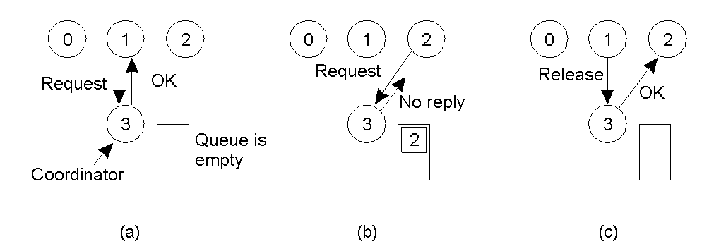
Mutual Exclusion: A Centralized Algorithm
Process 1 asks the coordinator for permission to enter a critical region. Permission is granted
Process 2 then asks permission to enter the same critical region. The coordinator does not reply.
When process 1 exits the critical region, it tells the coordinator, which then replies to 2

Slide 10
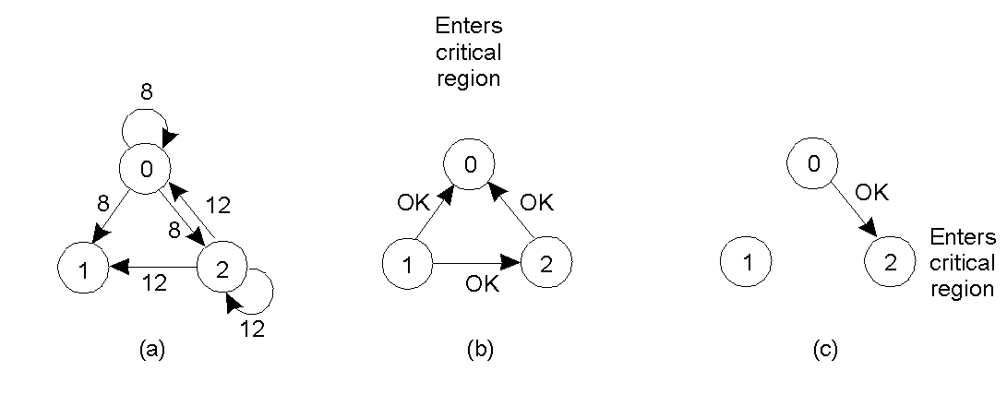
A Distributed Algorithm
Two processes want to enter the same critical region at the same moment.
Process 0 has the lowest timestamp, so it wins.
When process 0 is done, it sends an OK also, so 2 can now enter the critical region.

Slide 11
Non-token Based Algorithms
Notations:
  Si: Site i
  Ri: Request set, containing the ids of all sites(processes) from which permission must be received before accessing CS.
  Non-token based approaches use time stamps to order requests for CS.
  Smaller time stamps get priority over larger ones.
Lamport’s Algorithm
  Ri = {S1, S2, …, Sn}, i.e., all sites.
  Request queue: maintained at each Si. Ordered by time stamps.
  Assumption: message delivered in FIFO.

Slide 12
Lamport’s Algorithm
Requesting CS:
  Send REQUEST(tsi, i). (tsi,i): Request time stamp. Place REQUEST in request_queuei.
  On receiving the message; sj sends time-stamped REPLY message to si. Si’s request placed in request_queuej.
Executing CS:
  Si has received a message with time stamp larger than (tsi,i) from all other sites.
Releasing CS:
  Exiting CS: send a time stamped RELEASE message to all sites in its request set.
  Receiving RELEASE message: Sj removes Si’s request from its queue.

Slide 13
Lamport’s Algorithm…
Performance.
  3(N-1) messages per CS invocation.
    (N - 1) REQUEST, (N - 1) REPLY, (N - 1) RELEASE messages.
  Synchronization delay: T

Slide 14
Lamport’s Algorithm: Example-1
Step 1:
S1
(2,1)
S2
(1,2)
S3
Step 2:
S1
(1,2) (2,1)
S2 enters CS
S2
(1,2) (2,1)
S3
(1,2) (2,1)

Slide 15
Lamport’s: Example…
Step 3:
S1
(1,2) (2,1)
S2 leaves CS
S2
(1,2) (2,1)
S3
(1,2) (2,1)
Step 4:
S1
(1,2) (2,1)
(2,1)
S1 enters CS
S2
(1,2) (2,1)
(2,1)
S3
(1,2) (2,1)
(2,1)

Slide 16
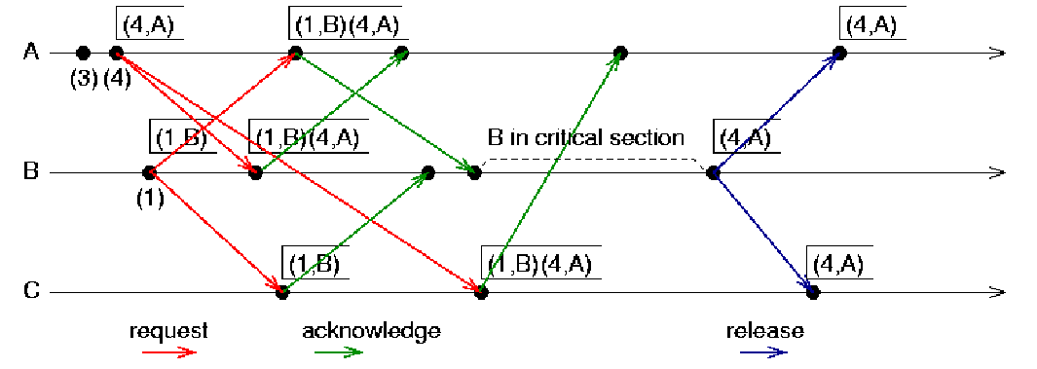
Example-2

Slide 17
Ricart-Agrawala Algorithm
Requesting critical section
  Si sends time stamped REQUEST message
  Sj sends REPLY to Si, if
    Sj is not requesting nor executing CS
    If Sj is requesting CS and Si’s time stamp is smaller than its own request.
    Request is deferred(postponed) otherwise.
Executing CS: after it has received REPLY from all sites in its request set.
Releasing CS: Send REPLY to all deferred requests. i.e., a site’s REPLY messages are blocked only by sites with smaller time stamps

Slide 18
Ricart-Agrawala: Performance
Performance:
  2(N-1) messages per CS execution.
    (N-1) REQUEST + (N-1) REPLY.
  Synchronization delay: T.

Slide 19
Ricart-Agrawala: Example
Step 1:
S1
(2,1)
S2
(1,2)
S3
Step 2:
S1
(1,2) (2,1)
S2 enters CS
S2
(1,2)(2,1)
S3
(1,2)
(2,1)

Slide 20
Ricart-Agrawala: Example…
Step 3:
S1
S1 enters CS
S2
(1,2)(2,1)
S2 leaves CS
S3

Slide 21
Maekawa’s Algorithm
A site requests permission only from a subset of sites.
Request set of sites si & sj: Ri, Rj such that Ri and Rj will have atleast one common site (Sk). Sk mediates conflicts between Ri and Rj.
A site can send only one REPLY message at a time, i.e., a site can send a REPLY message only after receiving a RELEASE message for the previous REPLY message.
Request Sets Rules:
  Sets Ri and Rj have atleast one common site.
  Si is always in Ri.
  Cardinality of Ri, i.e., the number of sites in Ri is K.
  Any site Si is in K number of Ris. N = K(K - 1) + 1 -> K = square root of N.

Slide 22
Maekawa’s Algorithm ...
Requesting CS
  Si sends REQUEST(i) to sites in Ri.
  Sj sends REPLY to Si if
    Sj has NOT sent a REPLY message to any site after it received the last RELEASE message.
    Otherwise, queue up Si’s request.
Executing CS: after getting REPLY from all sites in Ri.
Releasing CS
  send RELEASE(i) to all sites in Ri
  Any Sj after receiving RELEASE message, send REPLY message to the next request in queue.
  If queue empty, update status indicating receipt of RELEASE.

Slide 23
Maekawa’s Algorithm ...
Performance
  Synchronization delay: 2T
  Messages: 3 times square root of N (one each for REQUEST, REPLY, RELEASE messages)
Deadlocks
  Message deliveries are not ordered.
  Assume Si, Sj, Sk concurrently request CS
  Ri intersection Rj = {Sij}, Rj Rk = {Sjk}, Rk Ri = {Ski}
  Possible that:
    Sij is locked by Si (forcing Sj to wait at Sij)
    Sjk by Sj (forcing Sk to wait at Sjk)
    Ski by Sk (forcing Si to wait at Ski)
    -> deadlocks among Si, Sj, and Sk.

Slide 24
Token-based Algorithms
Unique token circulates among the participating sites.
A site can enter CS if it has the token.
Token-based approaches use sequence numbers instead of time stamps.
  Request for a token contains a sequence number.
  Sequence number of sites advance independently.
Correctness issue is trivial since only one token is present -> only one site can enter CS.
Deadlock and starvation issues to be addressed.

Slide 25
Suzuki-Kasami Algorithm
If a site without a token needs to enter a CS, broadcast a REQUEST for token message to all other sites.
Token: (a) Queue of request sites (b) Array LN[1..N], the sequence number of the most recent execution by a site j.
Token holder sends token to requestor, if it is not inside CS. Otherwise, sends after exiting CS.
Token holder can make multiple CS accesses.
Design issues:
  Distinguishing outdated REQUEST messages.
    Format: REQUEST(j,n) -> jth site making nth request.
    Each site has RNi[1..N] -> RNi[j] is the largest sequence number of request from j.
  Determining which site has an outstanding token request.
    If LN[j] = RNi[j] - 1, then Sj has an outstanding request.

Slide 26
Suzuki-Kasami Algorithm ...
Passing the token
  After finishing CS
  (assuming Si has token), LN[i] := RNi[i]
  Token consists of Q and LN. Q is a queue of requesting sites.
  Token holder checks if RNi[j] = LN[j] + 1. If so, place j in Q.
  Send token to the site at head of Q.
Performance
  0 to N messages per CS invocation.
  Synchronization delay is 0 (if the token holder repeats CS) or T.

Slide 27
Example
req=[1,0,0,0,0]
req=[1,0,0,0,0]
last=[0,0,0,0,0]
1
0
2
req=[1,0,0,0,0]
4
req=[1,0,0,0,0]
3
req=[1,0,0,0,0]
initial state

Slide 28
Example
req=[1,1,1,0,0]
req=[1,1,1,0,0]
last=[0,0,0,0,0]
1
0
2
req=[1,1,1,0,0]
4
req=[1,1,1,0,0]
3
req=[1,1,1,0,0]
1 & 2 send requests

Slide 29
Example
req=[1,1,1,0,0]
req=[1,1,1,0,0]
last=[1,0,0,0,0]
Q=(1,2)
1
0
2
req=[1,1,1,0,0]
4
req=[1,1,1,0,0]
3
req=[1,1,1,0,0]
0 prepares to exit CS

Slide 30
Example
req=[1,1,1,0,0]
last=[1,0,0,0,0]
Q=(2)
req=[1,1,1,0,0]
1
0
2
req=[1,1,1,0,0]
4
req=[1,1,1,0,0]
3
req=[1,1,1,0,0]
0 passes token to 1

Slide 31
Example
req=[2,1,1,1,0]
last=[1,0,0,0,0]
Q=(2,0,3)
req=[2,1,1,1,0]
1
0
2
req=[2,1,1,1,0]
4
req=[2,1,1,1,0]
3
req=[2,1,1,1,0]
0 and 3 send requests

Slide 32
Example
req=[2,1,1,1,0]
req=[2,1,1,1,0]
1
0
2
req=[2,1,1,1,0]
last=[1,1,0,0,0]
Q=(0,3)
4
req=[2,1,1,1,0]
3
req=[2,1,1,1,0]
1 sends token to 2

Slide 33
Raymond’s Algorithm
Sites are arranged in a logical directed tree. Root: token holder. Edges: directed towards root.
Every site has a variable holder that points to an immediate neighbor node, on the directed path towards root. (Root’s holder point to itself).
Requesting CS
  If Si does not hold token and request CS, sends REQUEST upwards provided its request_q is empty. It then adds its request to request_q.
  Non-empty request_q -> REQUEST message for top entry in q (if not done before).
  Site on path to root receiving REQUEST -> propagate it up, if its request_q is empty. Add request to request_q.
  Root on receiving REQUEST -> send token to the site that forwarded the message. Set holder to that forwarding site.
  Any Si receiving token -> delete top entry from request_q, send token to that site, set holder to point to it. If request_q is non-empty now, send REQUEST message to the holder site.

Slide 34
Raymond’s Algorithm …
Executing CS: getting token with the site at the top of request_q. Delete top of request_q, enter CS.
Releasing CS
  If request_q is non-empty, delete top entry from q, send token to that site, set holder to that site.
  If request_q is non-empty now, send REQUEST message to the holder site.
Performance
  Average messages: O(log N) as average distance between 2 nodes in the tree is O(log N).
  Synchronization delay: (T log N) / 2, as average distance between 2 sites to successively execute CS is (log N) / 2.
  Greedy approach: Intermediate site getting the token may enter CS instead of forwarding it down. Affects fairness, may cause starvation.

Slide 35
Raymond’s Algorithm: Example
Step 1:
Token
holder
S1
S2
Token
request
S3
S4
S5
S6
S7
Step 2:
S1
S2
Token
S3
S4
S5
S6
S7

Slide 36
Raymond’s Algm.: Example…
Step 3:
S1
S2
S3
S4
S5
S6
S7
Token
holder

Slide 37
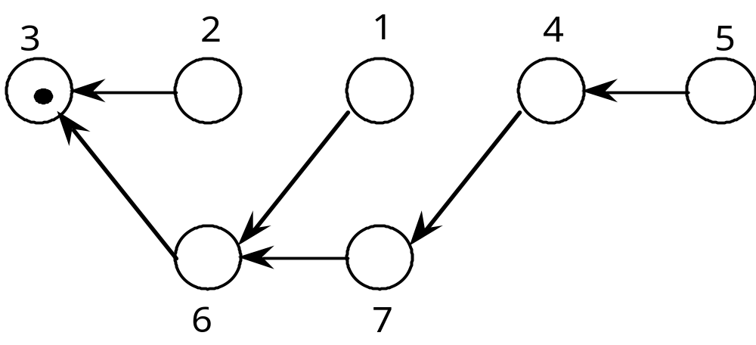
Example-
1
4
1
4,7
1,4
1,4,7 want to enter their CS

Slide 38
Raymond’s Algorithm
1
4
1,4
4,7
2 sends the token to 6

Slide 39
Raymond’s Algorithm
4
4
4
4,7
6 forwards the token to 1

Slide 40
Singhal’s Heuristic Algorithm
Instead of broadcast: each site maintains information on other sites, guess the sites likely to have the token.
Data Structures:
  Si maintains SVi[1..N] and SNi[1..N] for storing information on other sites: state and highest sequence number.
  Token contains 2 arrays: TSV[1..N] and TSN[1..N].
  States of a site
    R : requesting CS
    E : executing CS
    H : Holding token, idle
    N : None of the above
  Initialization:
    SVi[j] := N, for j = N .. i; SVi[j] := R, for j = i-1 .. 1; SNi[j] := 0, j = 1..N. S1 (Site 1) is in state H.
    Token: TSV[j] := N & TSN[j] := 0, j = 1 .. N.

Slide 41
Singhal’s Heuristic Algorithm …
Requesting CS
  If Si has no token and requests CS:
    SVi[i] := R. SNi[i] := SNi[i] + 1.
    Send REQUEST(i,sn) to sites Sj for which SVi[j] = R. (sn: sequence number, updated value of SNi[i]).
  Receiving REQUEST(i,sn): if sn <= SNj[i], ignore. Otherwise, update SNj[i] and do:
    SVj[j] = N -> SVj[i] := R.
    SVj[j] = R -> If SVj[i] != R, set it to R & send REQUEST(j,SNj[j]) to Si. Else do nothing.
    SVj[j] = E -> SVj[i] := R.
    SVj[j] = H -> SVj[i] := R, TSV[i] := R, TSN[i] := sn, SVj[j] = N. Send token to Si.
Executing CS: after getting token. Set SVi[i] := E.

Slide 42
Singhal’s Heuristic Algorithm …
Releasing CS
  SVi[i] := N, TSV[i] := N. Then, do:
    For other Sj: if (SNi[j] > TSN[j]), then {TSV[j] := SVi[j]; TSN[j] := SNi[j]}
    else {SVi[j] := TSV[j]; SNi[j] := TSN[j]}
  If SVi[j] = N, for all j, then set SVi[i] := H. Else send token to a site Sj provided SVi[j] = R.
Fairness of algorithm will depend on choice of Si, since no queue is maintained in token.
Arbitration rules to ensure fairness used.
Performance
  Low to moderate loads: average of N/2 messages.
  High loads: N messages (all sites request CS).
  Synchronization delay: T.

Slide 43
Singhal: Example
Assume there are 3 sites in the system. Initially:
Site 1: SV1[1] = H, SV1[2] = N, SV1[3] = N. SN1[1], SN1[2], SN1[3] are 0.
Site 2: SV2[1] = R, SV2[2] = N, SV2[3] = N. SNs are 0.
Site 3: SV3[1] = R, SV3[2] = R, SV3[3] = N. SNs are 0.
Token: TSVs are N. TSNs are 0.
Assume site 2 is requesting token.
S2 sets SV2[2] = R, SN2[2] = 1.
S2 sends REQUEST(2,1) to S1 (since only S1 is set to R in SV[2])
S1 receives the REQUEST. Accepts the REQUEST since SN1[2] is smaller than
the message sequence number.
Since SV1[1] is H: SV1[2] = R, TSV[2] = R, TSN[2] = 1, SV1[1] = N.
Send token to S2
S2 receives the token. SV2[2] = E. After exiting the CS, SV2[2] = TSV[2] = N.
Updates SN, SV, TSN, TSV. Since nobody is REQUESTing, SV2[2] = H.
Assume S3 makes a REQUEST now. It will be sent to both S1 and S2. Only S2
responds since only SV2[2] is H (SV1[1] is N now).

Slide 44
Comparison
Non-Token Resp. Time(ll) Sync. Delay Messages(ll) Messages(hl)
Lamport 2T+E T 3(N-1) 3(N-1)
Ricart-Agrawala 2T+E T 2(N-1) 2(N-1)
Maekawa 2T+E 2T 3*sq.rt(N) 5*sq.rt(N)
Token Resp. Time(ll) Sync. Delay Messages(ll) Messages(hl)
Suzuki-Kasami 2T+E T N N
Singhal 2T+E T N/2 N
Raymond T(log N)+E Tlog(N)/2 log(N) 4

